Slide 1
Dropout的隐式正则化
Cat book
2024年5月

Slide 2
回顾参数凝聚

Slide 3
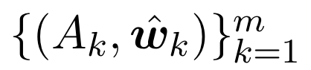
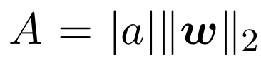
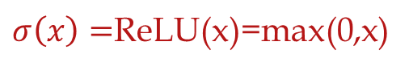
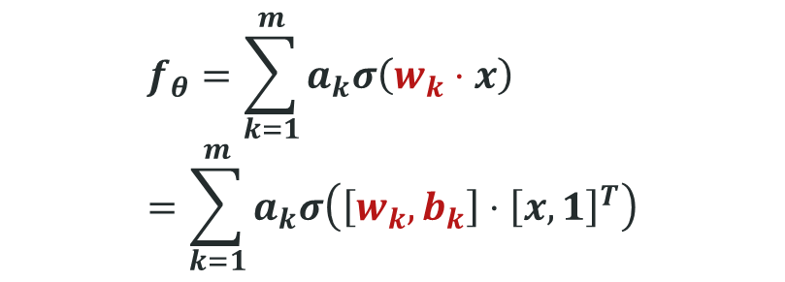

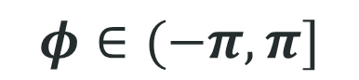
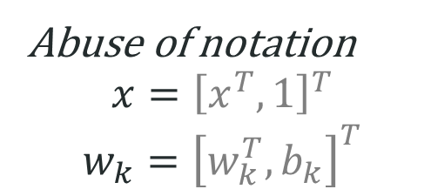
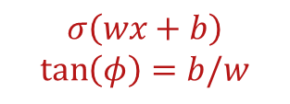
2-layer ReLU neural network
$$f_{θ}=\sum_{k=1}^{m}{a_{k}σ\left(w_{k}⋅x\right)}=\sum_{k=1}^{m}{a_{k}σ\left(\left[w_{k},b_{k}\right]⋅{\left[x,1\right]}^{T}\right)}$$
For 1d input, $w_{k}$ is a 2d vector.
We use $φ$ to denote its orientation
$σ\left(x\right)=$ReLU(x)=max(0,x)
Abuse of notation
$$x={\left[x^{T},1\right]}^{T}$$
$$w_{k}={\left[w_{k}^{T},b_{k}\right]}^{T}$$
$$σ\left(wx+b\right)$$
$$\tan\left(φ\right)=b/w$$
$$φ∈(−π,π]$$
Angle---Turning point
Tao Luo#, Zhi-Qin John Xu #, Zheng Ma, Yaoyu Zhang*,
Phase diagram for two-layer ReLU neural networks at infinite-width limit, Journal of Machine Learning Research (2021)

Slide 4
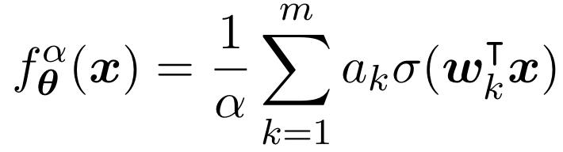
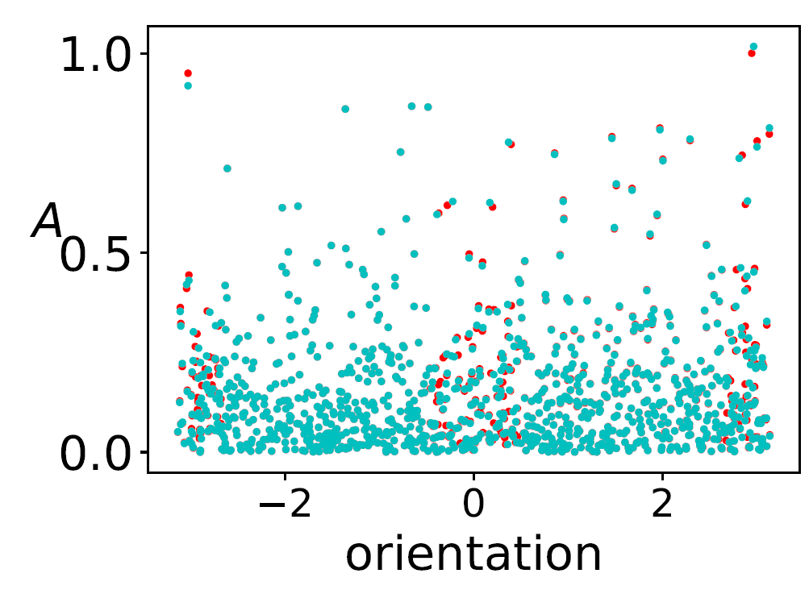
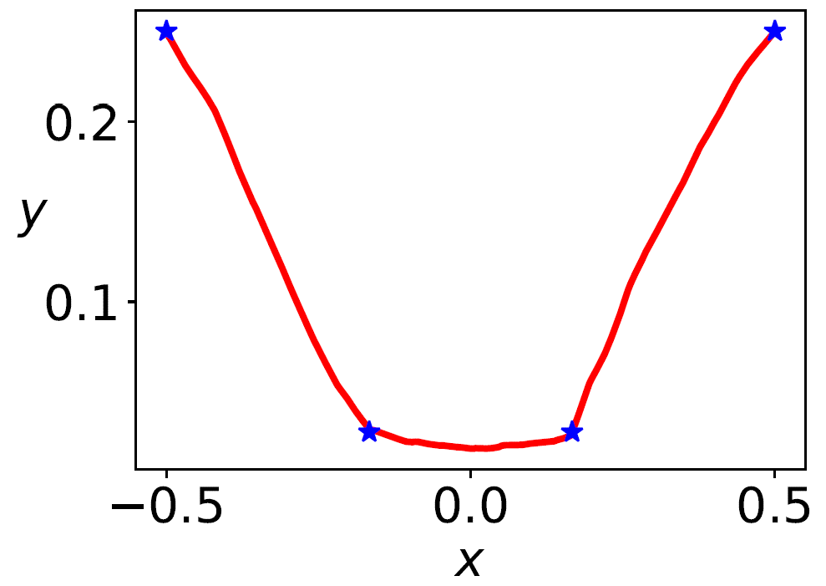
Linear regime
Initial→ → Final
However, NN’s power is not in linear regime.
Tao Luo#, Zhi-Qin John Xu #, Zheng Ma, Yaoyu Zhang*,
Phase diagram for two-layer ReLU neural networks at infinite-width limit, Journal of Machine Learning Research (2021)

Slide 5
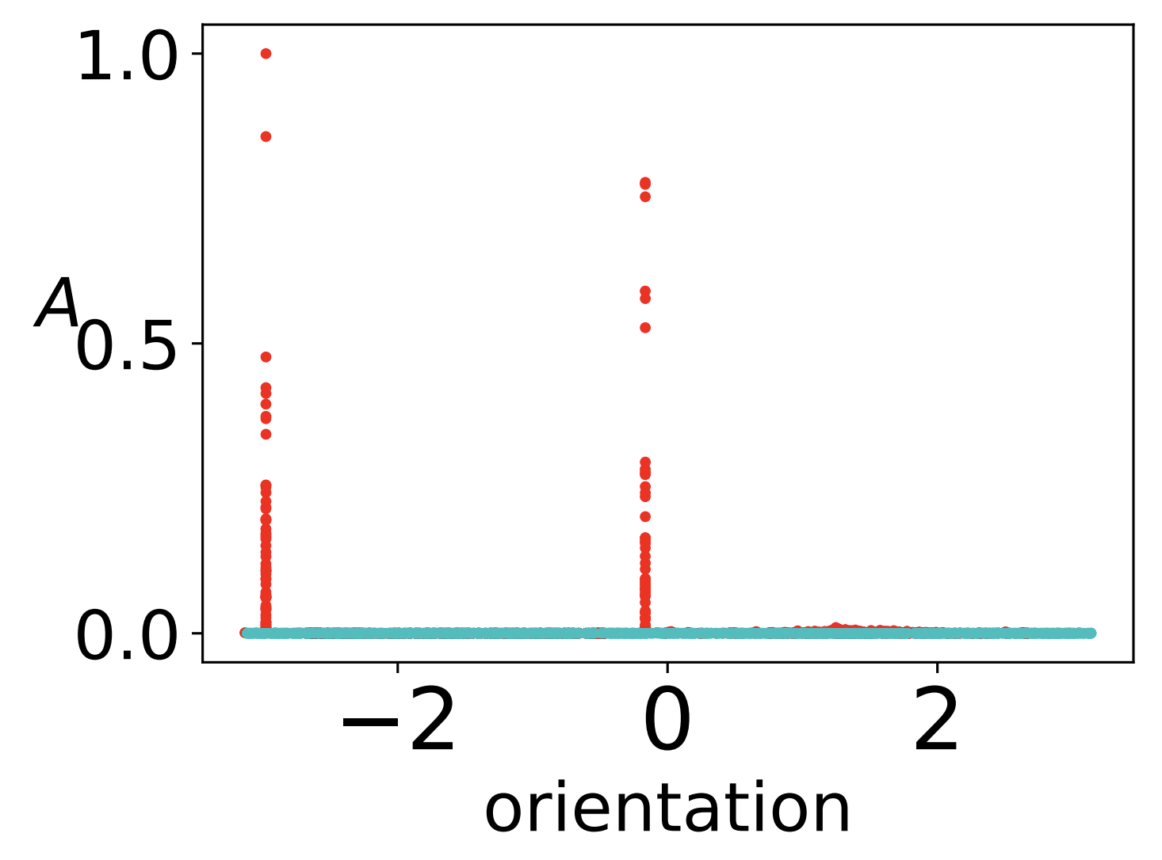
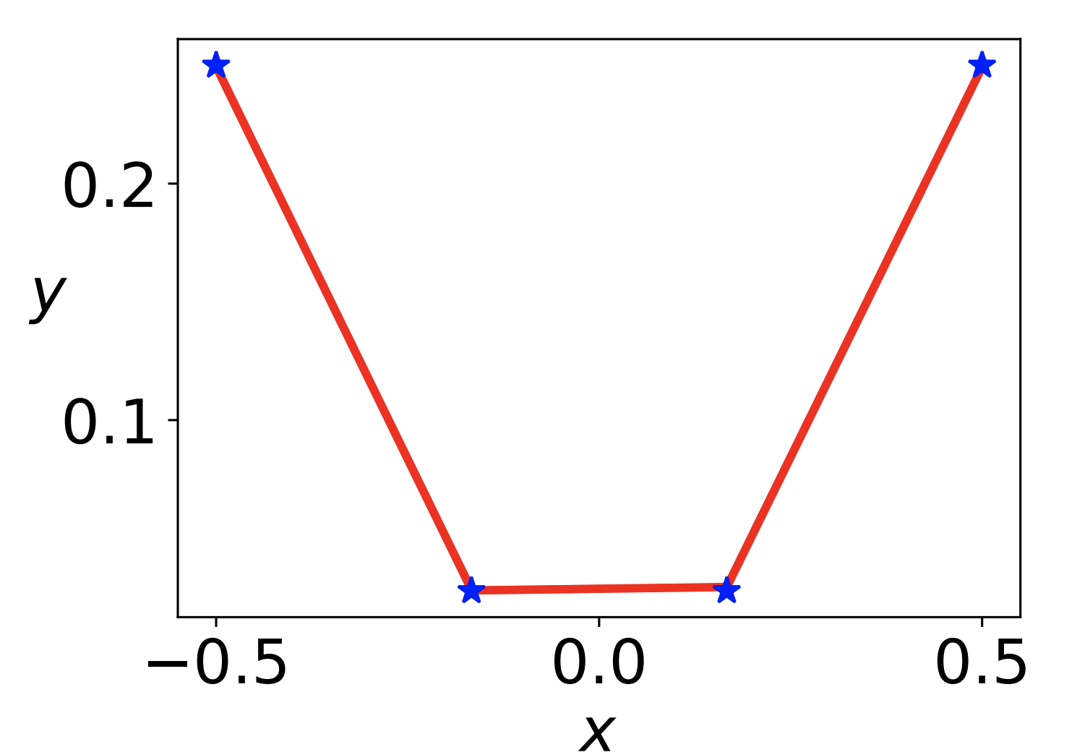
Condensation
Initial→ → Final
Tao Luo#, Zhi-Qin John Xu #, Zheng Ma, Yaoyu Zhang*,
Phase diagram for two-layer ReLU neural networks at infinite-width limit, Journal of Machine Learning Research (2021)

Slide 6
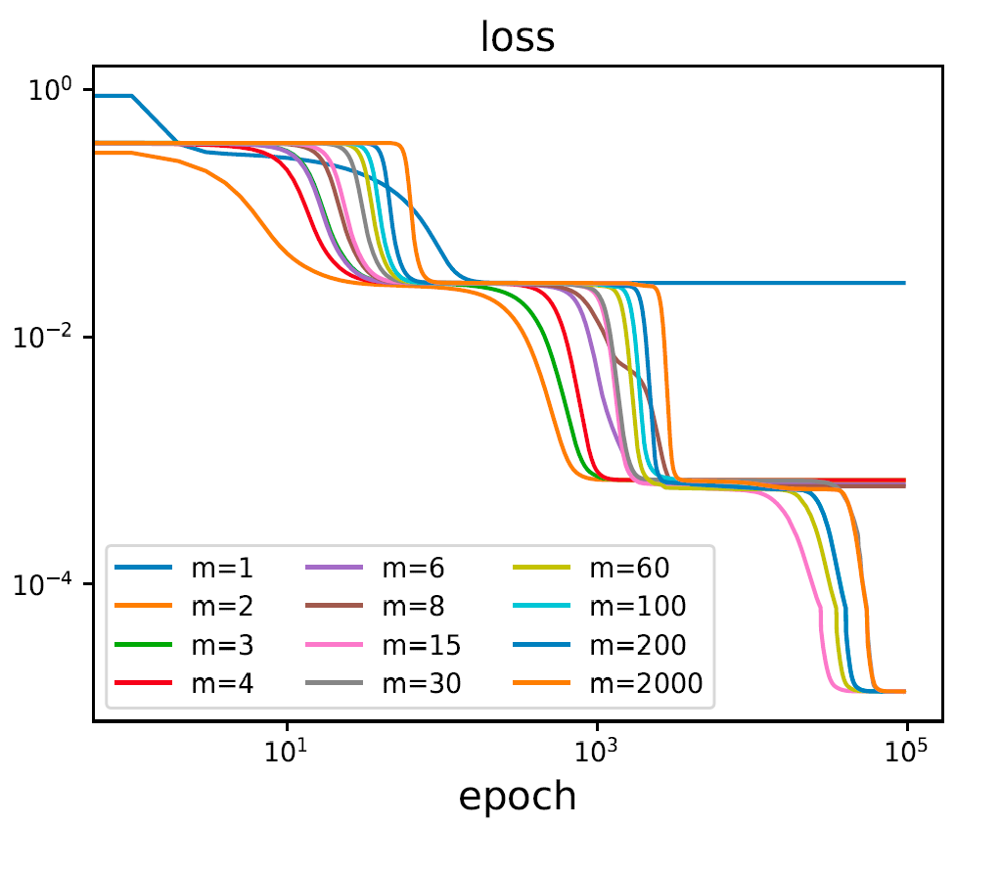
For GD, condensation requires small initialization. But training is too slow!

Slide 7
Can we find a way: Condensation and Fast training?

Slide 8
Dropout facilitates condensation in whole training! Even for large initialization!

Slide 9
Visualize implicit regularization by modified gradient flow
Implicit regularization on condensation
Implicit regularization on flatness

Slide 10
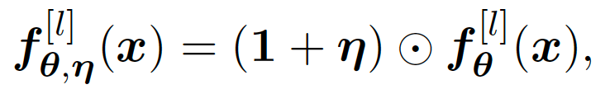
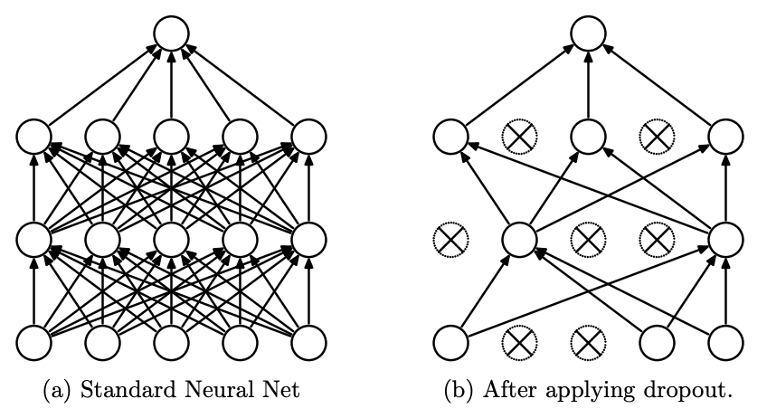
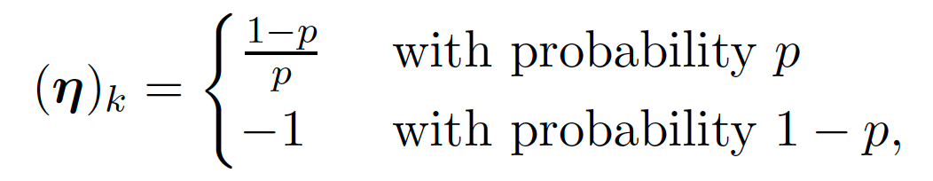
Dropout
If the dropout neurons are the same as those kept, nothing changed!
Srivastava et al., 2014 JMLR
Zhang and Xu*, Implicit regularization of dropout, arxiv: 2207.05952

Slide 11
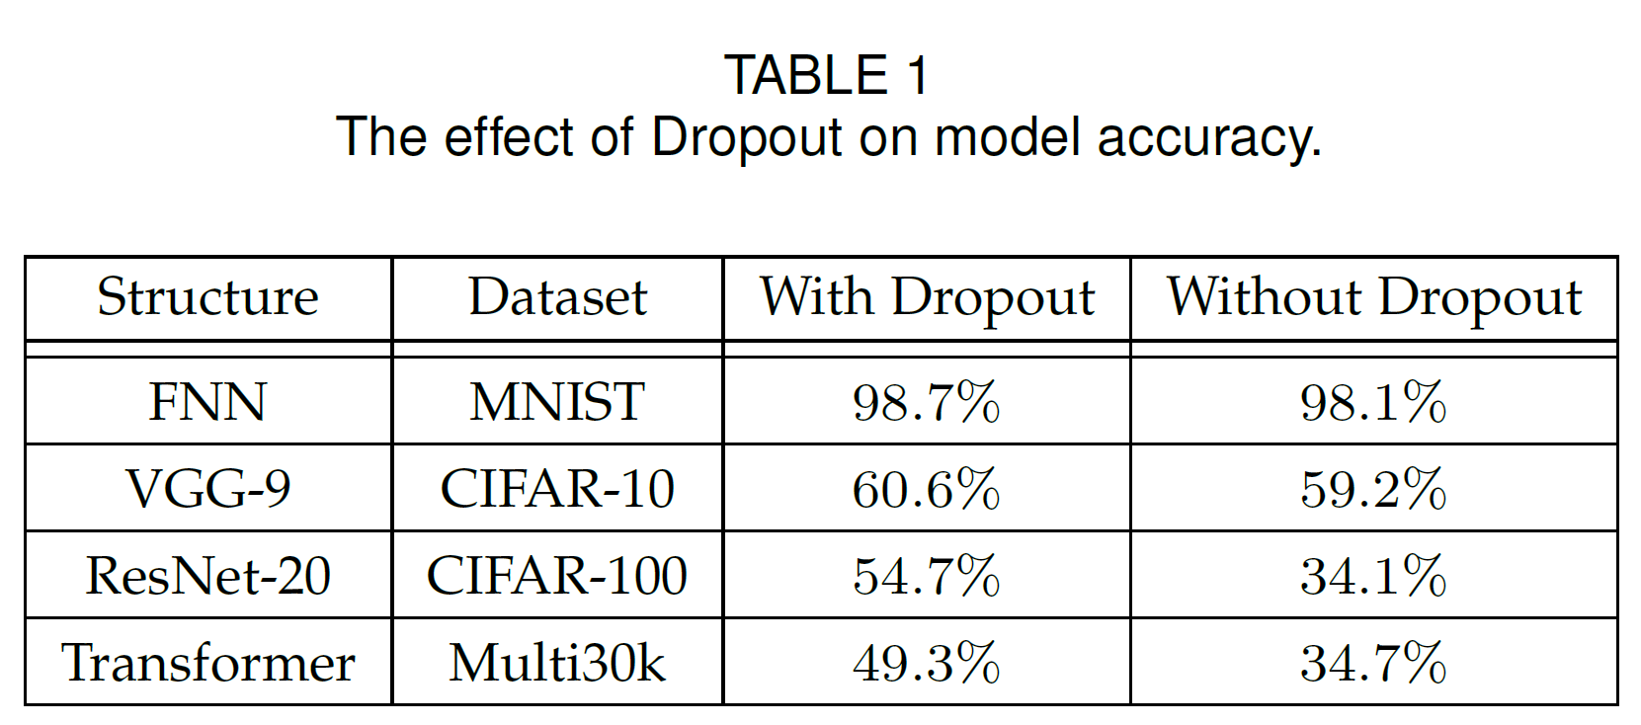
Dropout
What is implicit regularization of Dropout?
Zhang and Xu*, Implicit regularization of dropout, arxiv: 2207.05952
Notes:
we use ResNet-20 [39] to compare the loss landscape flatness w/o dropout layers. For experiments with dropout layers, we add dropout layers after the convolutional layers, the dropout rates of dropout
layers are 0.8.
Transformer: e apply dropout to the output of each sub-layer, before it is added to the sub-layer input and normalized.

Slide 12
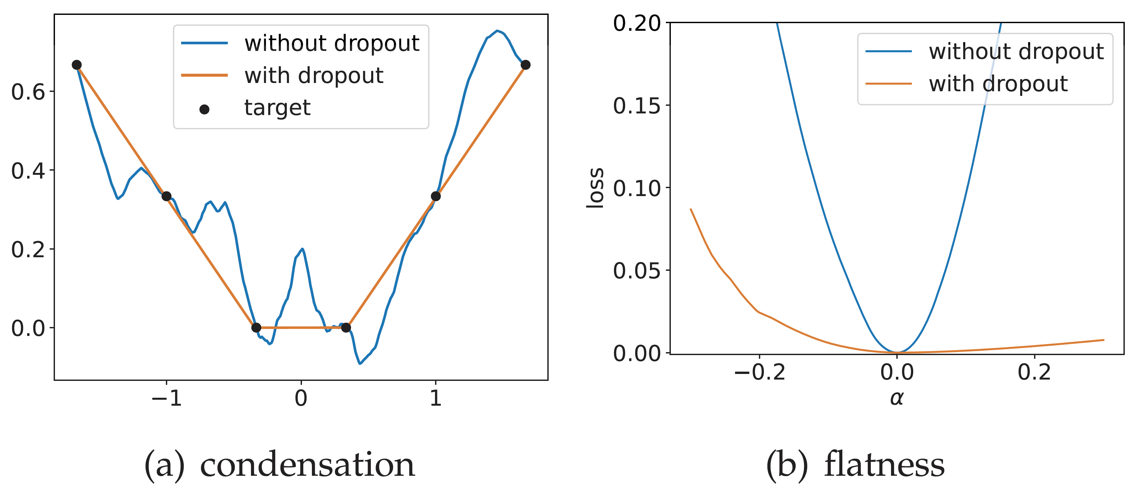
Condensation and flatness
Zhang and Xu*, Implicit regularization of dropout, arxiv: 2207.05952
Notes:
Two-layer ReLU NNs trained with and without dropout. The
width of the hidden layers is 1000, and the learning rate for different
experiments is 1 × 10−3. (a) The output of NNs with or without dropout.
(b) The loss value obtained by perturbing the network with or without
dropout in a given random direction, alpha is the step size moving in this
direction.

Slide 13
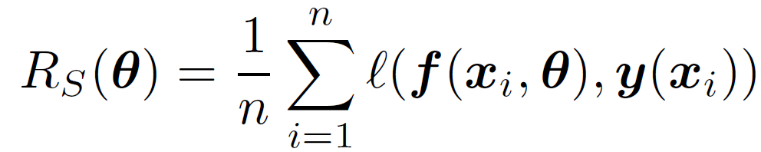
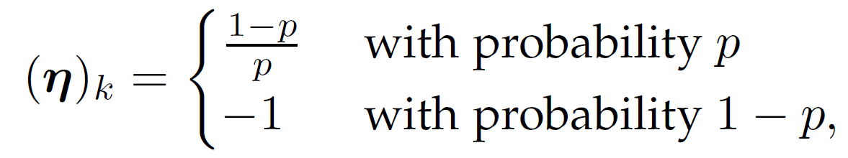
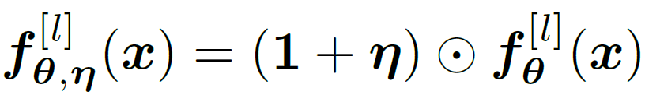
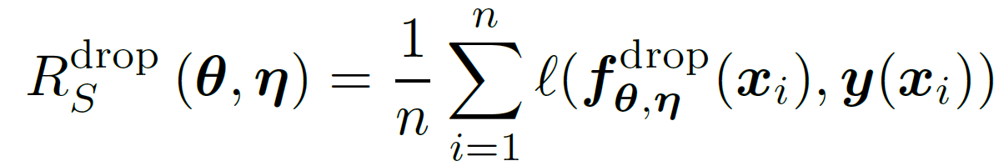
Dropout
Network
Loss function
Dropout variable
Dropout network
Dropout loss
Zhang and Xu*, Implicit regularization of dropout, arxiv: 2207.05952

Slide 14
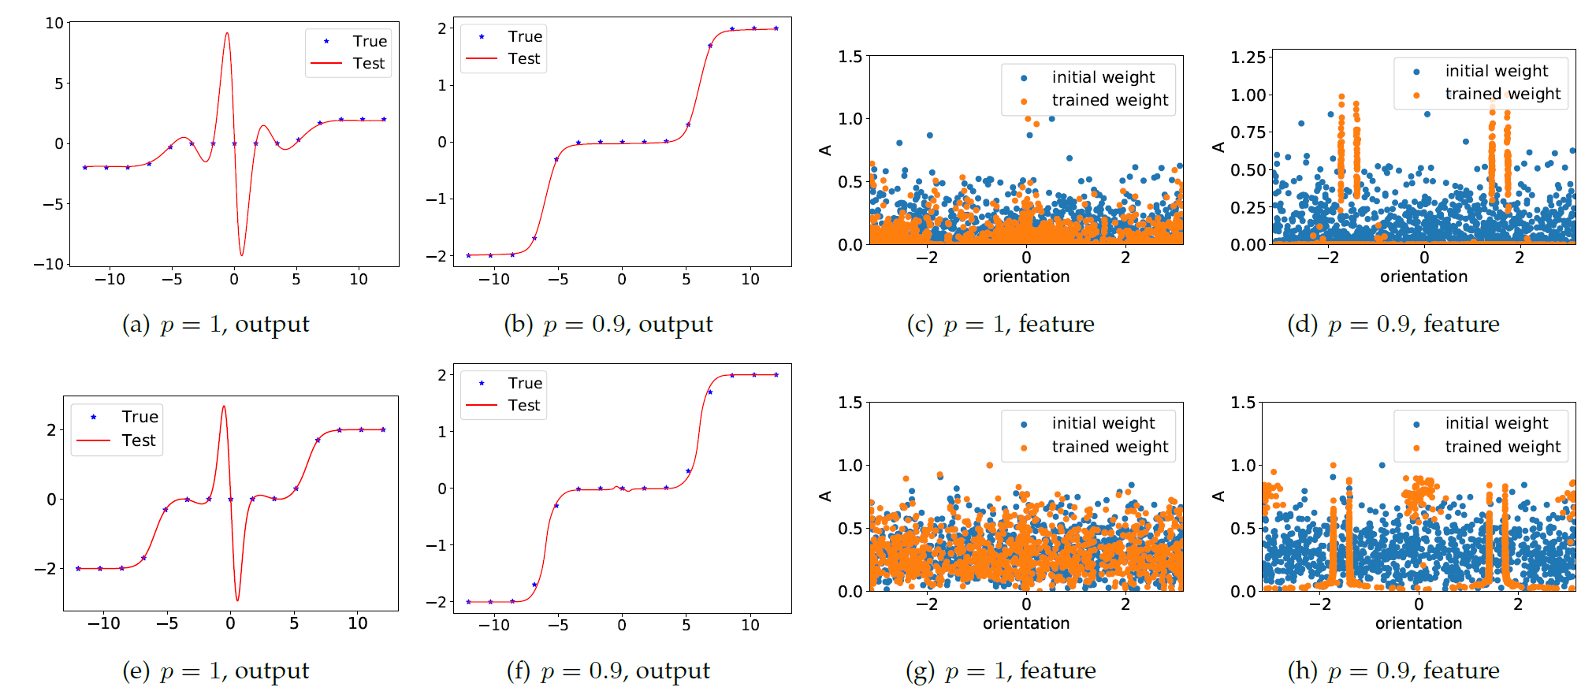
Dropout effect on condensation
Two-layer NNs
Three-layer NNs
width 1000
Zhang and Xu*, Implicit regularization of dropout, arxiv: 2207.05952

Slide 15
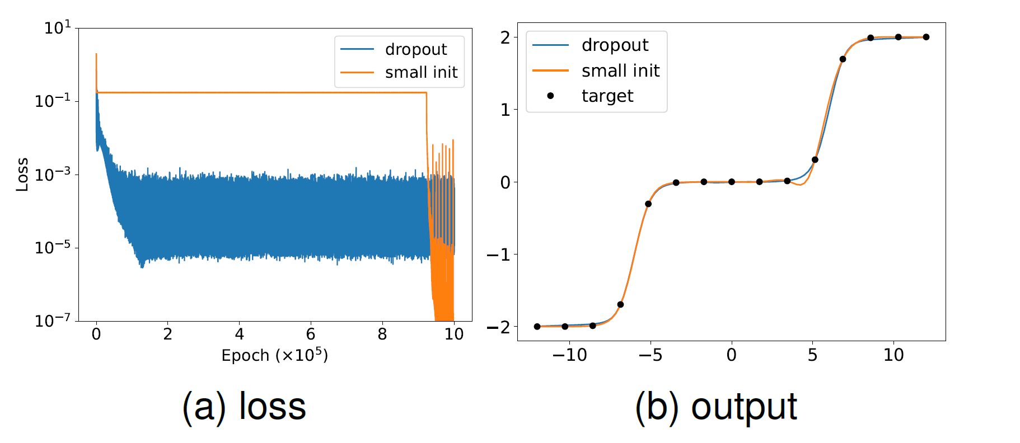
Dropout: condense+fast training

Slide 16
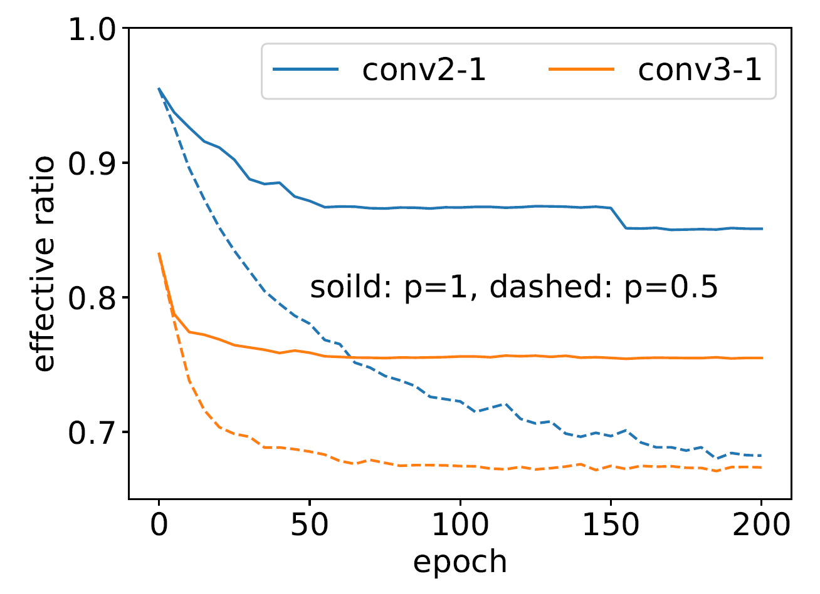
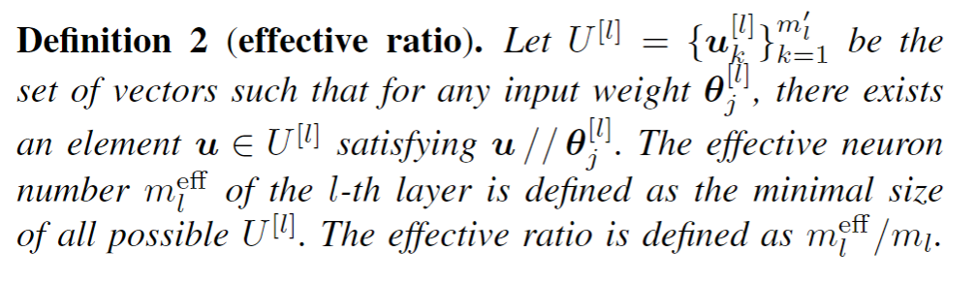
Dropout effect on condensation
Dropout network has fewer effective neurons.
Counted as one neuron if their inner product larger than 0.95.
CIFAR-10 classification with ResNet-18.
Zhang and Xu*, Implicit regularization of dropout, arxiv: 2207.05952

Slide 17
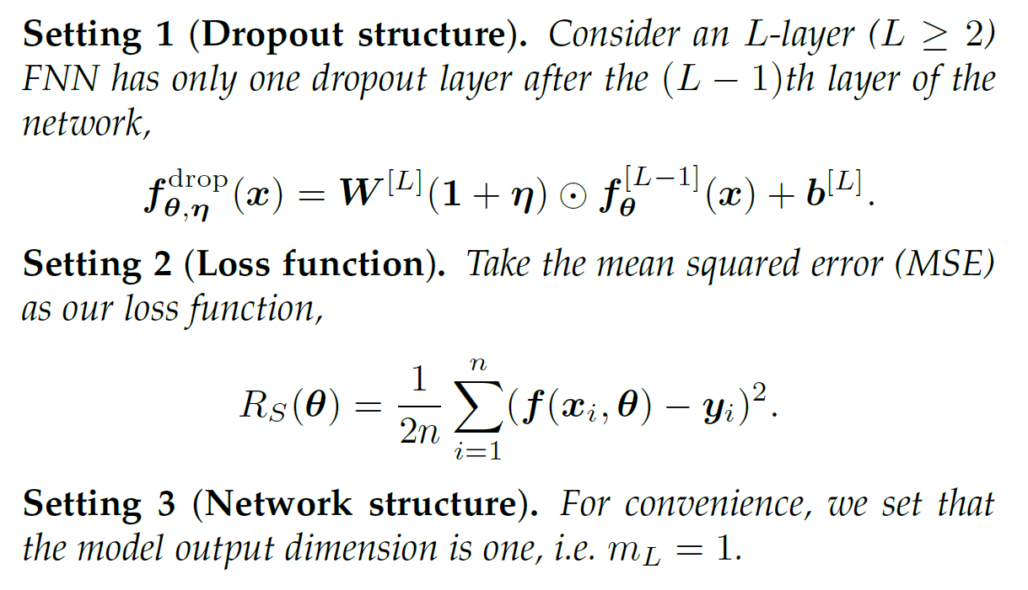
Dropout: theory settings
Zhang and Xu*, Implicit regularization of dropout, arxiv: 2207.05952

Slide 18
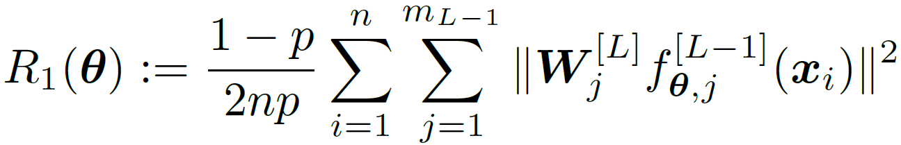
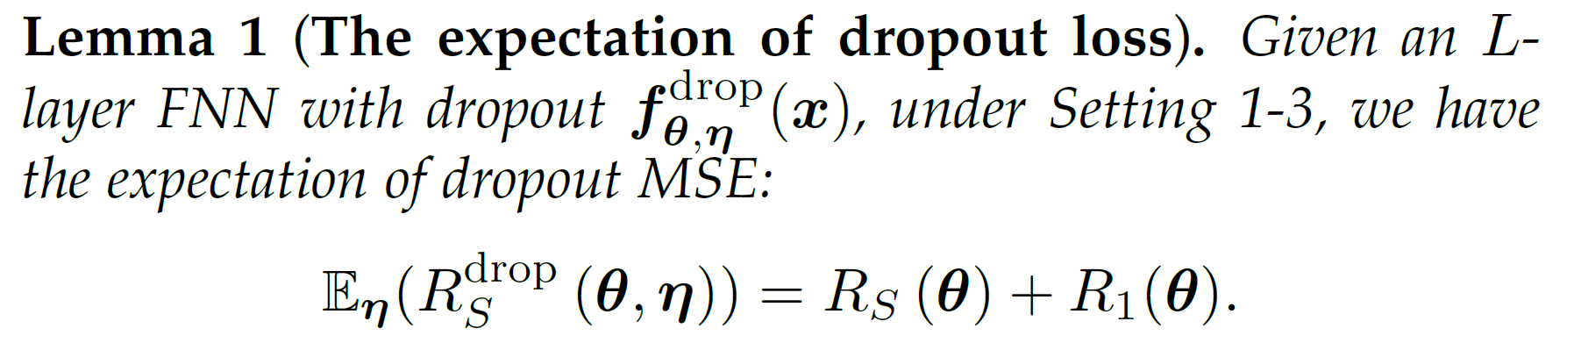
Dropout: Expected loss
Each sample
Each neuron’s output
Zhang and Xu*, Implicit regularization of dropout, arxiv: 2207.05952

Slide 19
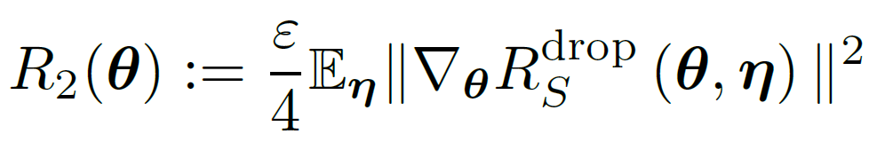
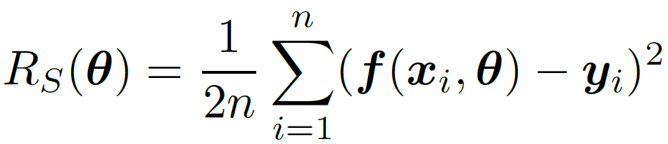
Modified gradient flow
Discretized gradient descent
Each sample
Each neuron’s output
Gradient flow
Modified gradient flow
Implicit regularization!
Zhang and Xu*, Implicit regularization of dropout, arxiv: 2207.05952

Slide 20
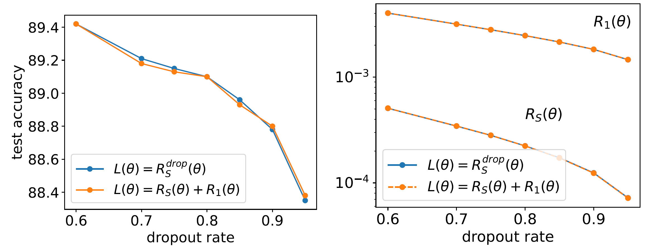

Validation of effect of $R_{1}(θ)$
Small learning rate $ε$
Two-layer NNs of width 1000,1000 images of MNIST
Zhang and Xu*, Implicit regularization of dropout, arxiv: 2207.05952

Slide 21
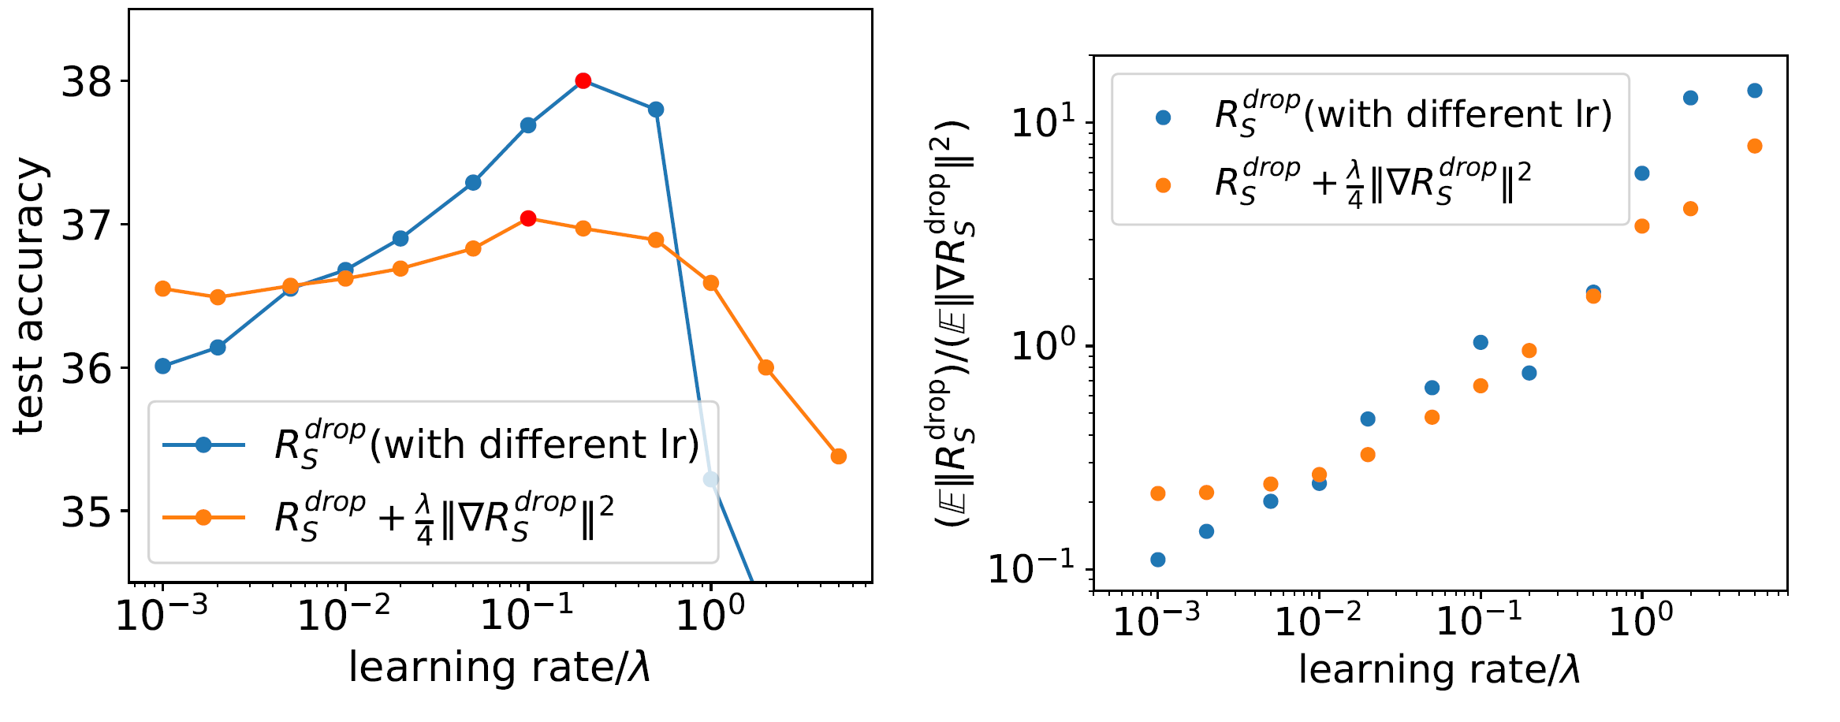
Validation of effect of $R_{2}(θ)$
VGG9, images of CIFAR-10
Zhang and Xu*, Implicit regularization of dropout, arxiv: 2207.05952

Slide 22
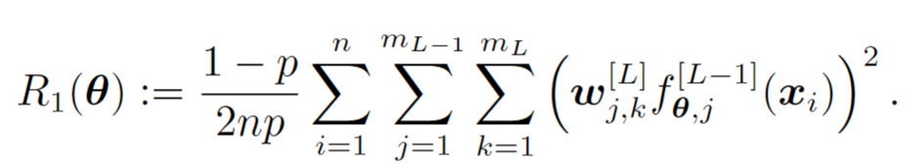
Dropout: Expected loss
Each sample
Each neuron’s output
Zhang and Xu*, Implicit regularization of dropout, arxiv: 2207.05952

Slide 23
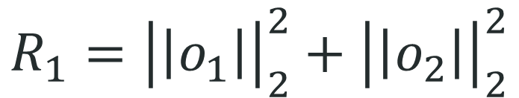
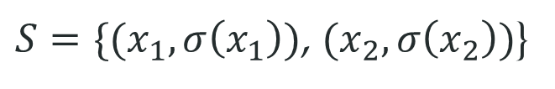
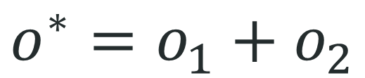
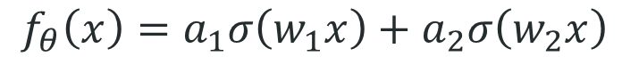
Implicit regularization of Dropout
model
$$f_{θ}\left(x\right)=a_{1}σ\left(w_{1}x\right)+a_{2}σ\left(w_{2}x\right)$$
Target data
$S=\{(x_{1},σ\left(x_{1}\right))$, $(x_{2},σ\left(x_{2}\right))$}
Perfect fitting
$$σ\left(x_{1}\right)=a_{1}σ\left(w_{1}x_{1}\right)+a_{2}σ\left(w_{2}x_{1}\right)$$
$$σ\left(x_{2}\right)=a_{1}σ\left(w_{1}x_{2}\right)+a_{2}σ\left(w_{2}x_{2}\right)$$
$$\left(σ\left(x_{1}\right),σ\left(x_{2}\right)\right)=(a_{1}σ\left(w_{1}x_{1}\right),a_{1}σ\left(w_{1}x_{2}\right))+(a_{2}σ\left(w_{2}x_{1}\right),a_{2}σ\left(w_{2}x_{2}\right))$$
$$o^{∗}=o_{1}+o_{2}$$
$$R_{1}={\left|\left|o_{1}\right|\right|}_{2}^{2}+{\left|\left|o_{2}\right|\right|}_{2}^{2}$$
Zhang and Xu*, Implicit regularization of dropout, arxiv: 2207.05952

Slide 24
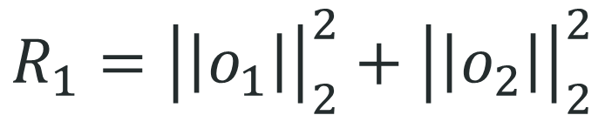
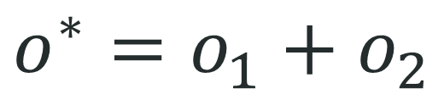
Implicit regularization of Dropout
$$o^{∗}=o_{1}+o_{2}$$
$$R_{1}={\left|\left|o_{1}\right|\right|}_{2}^{2}+{\left|\left|o_{2}\right|\right|}_{2}^{2}$$
Zhang and Xu*, Implicit regularization of dropout, arxiv: 2207.05952

Slide 25
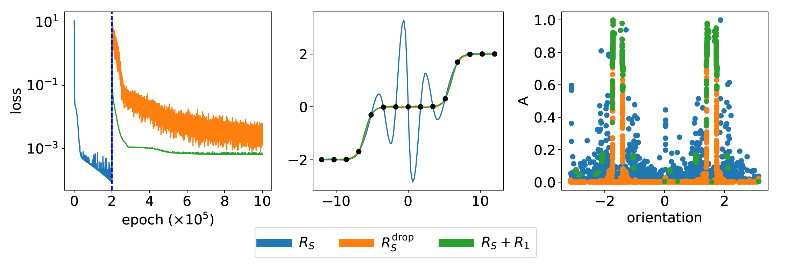
GD → GD+dropout
Zhang and Xu*, Implicit regularization of dropout, arxiv: 2207.05952

Slide 26
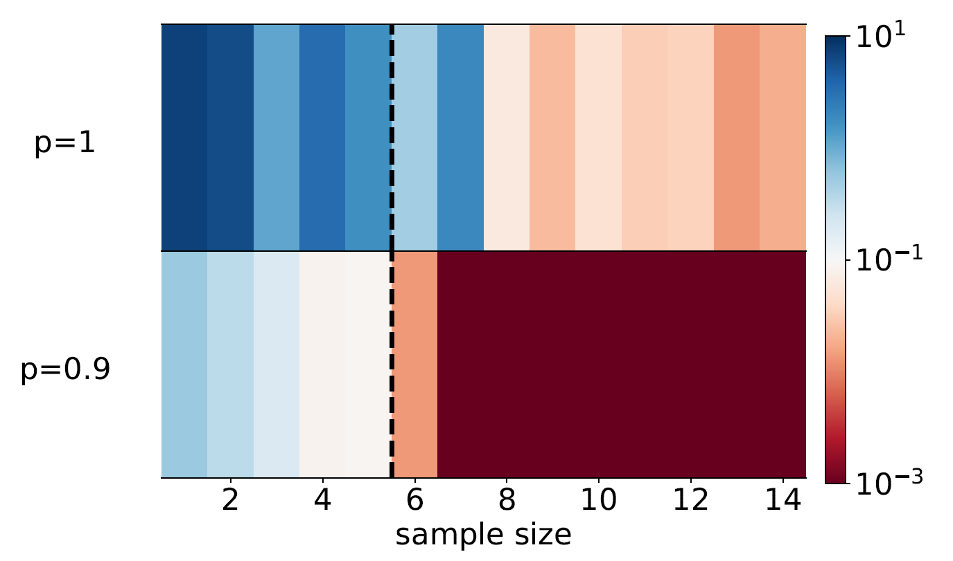
Dropout effect on generalization
Teacher student setup
Teacher network: two-layer tanh NN, width 2, 6 free parameters
Student network: two-layer tanh NN, width 1000, 3000 free parameters
Condensation: even large networks require few samples to generalize well!

Slide 27
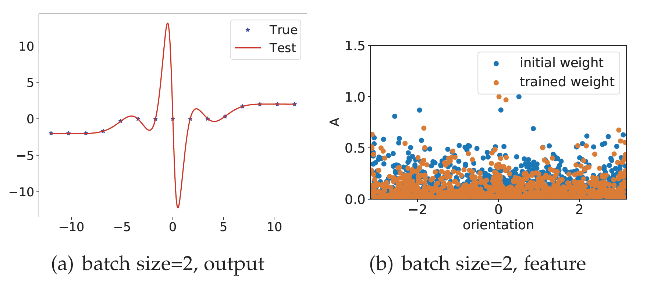
SGD NO effect on condensation
width 1000
Zhang and Xu*, Implicit regularization of dropout, arxiv: 2207.05952

Slide 28
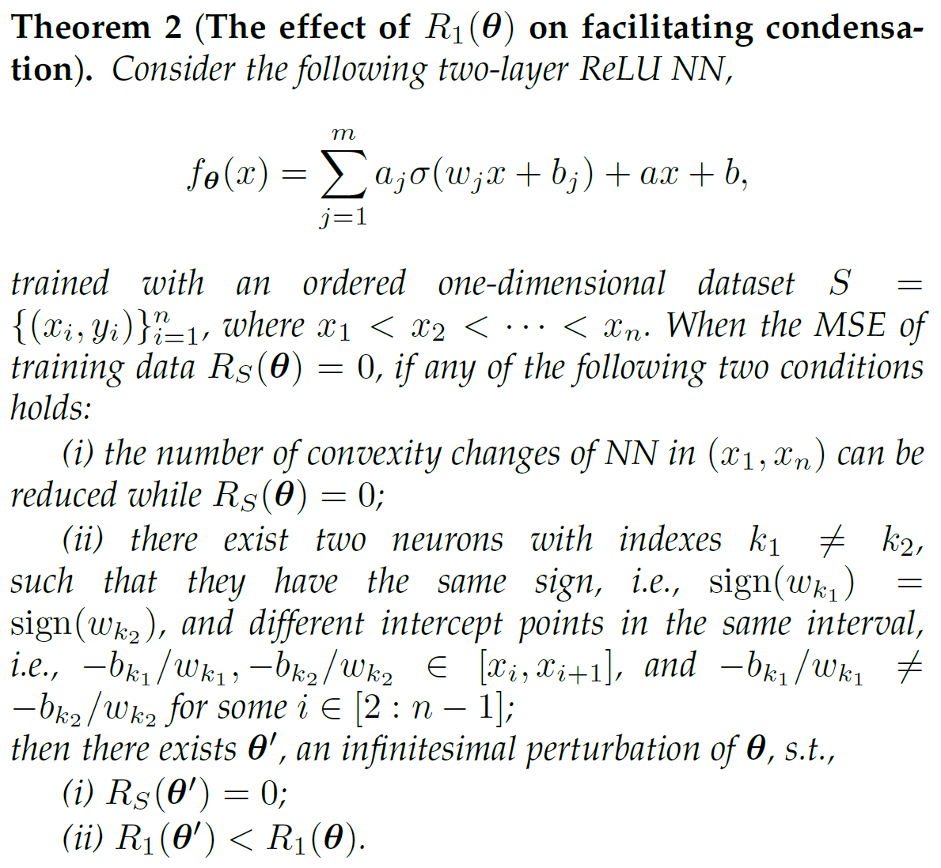
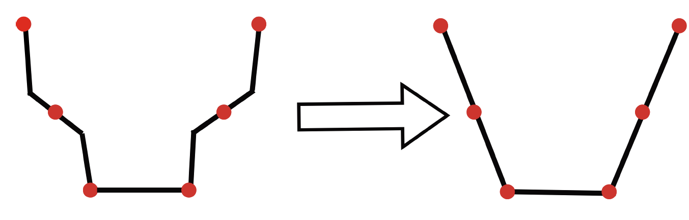
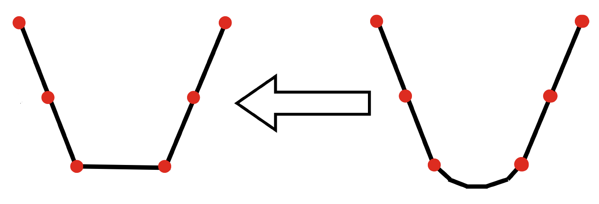
Implicit regularization of Dropout
Minimal convexity changes
intercept point limit
Zhang and Xu*, Implicit regularization of dropout, arxiv: 2207.05952

Slide 29
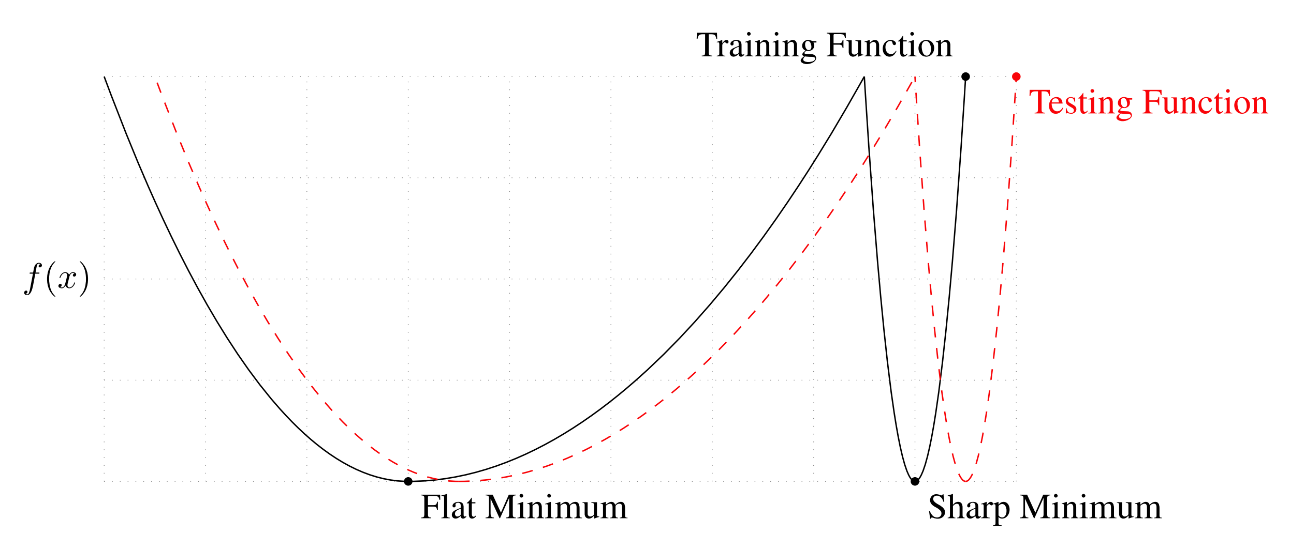
An Empirical Guess
Sepp Hochreiter and Jurgen Schmidhuber. Flat minima. Neural Computation, 9(1):1–42, 1997.

Slide 30
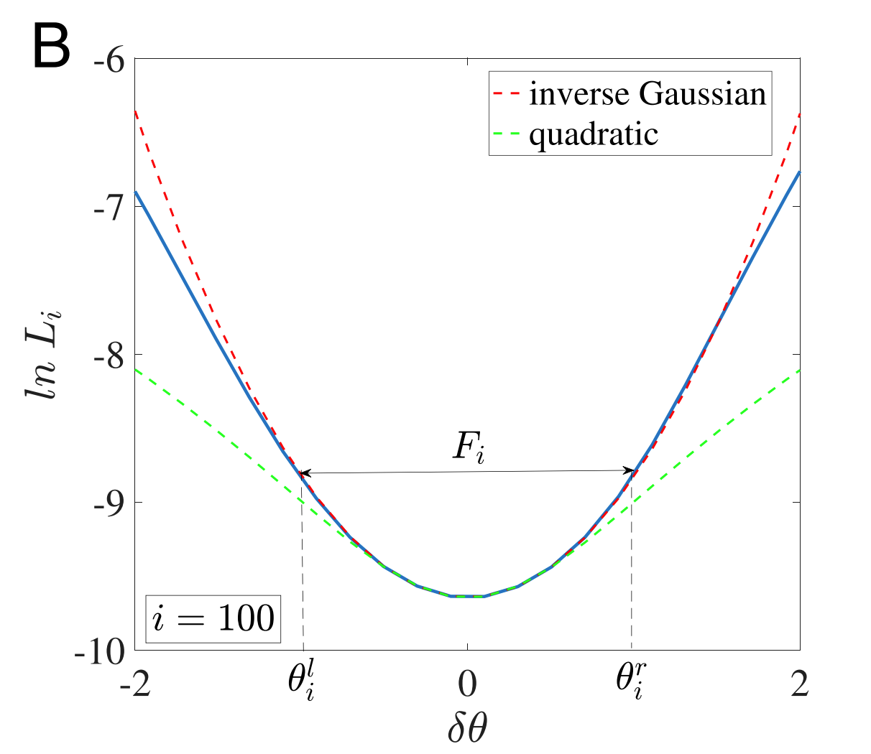
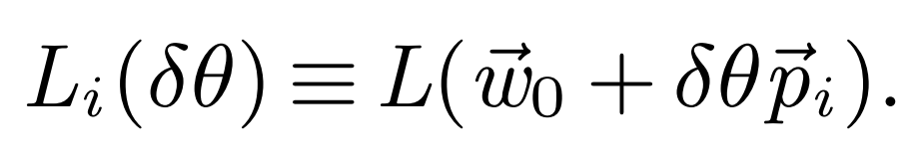
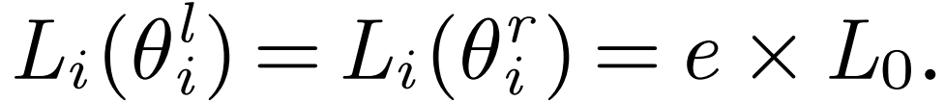

Definition of Flatness
Interval flatness

Slide 31





Definition of Flatness
$${H≔∇}^{2}L_{S}\left(θ\right)$$
Hessian flatness
$$Tr\left(H\right), λ_{max}\left(H\right)$$
NTK flatness
$$Tr\left(Θ\right),λ_{max}\left(Θ\right)$$
under the limit of infinite width
MSE loss:
3 classes CIFAR10
$H$: para size $∗$ para size, $Θ:$dataset size $∗$ dataset size

Slide 32

Dropout effect on flatness
Use method from H. Li, Z. Xu, G. Taylor, C. Studer, and T. Goldstein, “Visualizing
the loss landscape of neural nets,” arXiv preprint arXiv:1712.09913, 2017.

Slide 33

$R_{1}$ and $R_{2}$ on generalization
Two-layer NNs of width 1000,1000 images of MNIST

Slide 34





$R_{1}$ and $R_{2}$ on flatness
Two-layer NNs of width 1000,1000 images of MNIST

Slide 35



$R_{1}$ on flatness
$$∇R_{s}=\frac{1}{n}∑(f_{θ}\left(x_{i}\right)−f^{∗}\left(x_{i}\right))∇f_{θ}(x_{i})$$
$$∇^{2}R_{s}=\frac{1}{n}∑\left(f_{θ}\left(x_{i}\right)−f^{∗}\left(x_{i}\right)\right)∇^{2}f_{θ}\left(x_{i}\right)+\frac{1}{n}∑∇f_{θ}\left(x_{i}\right)∇^{T}f_{θ}(x_{i})$$
$$R_{s}\left(θ\right)=0$$

Slide 36
Visualize implicit regularization by modified gradient flow
小结
Implicit regularization on condensation
Implicit regularization on flatness

